Slide 1
RECURSION AND LAMBDA FUNCTIONS
PIYUSH VASHISTHA
ASST. PROFESSOR
CEA DEPT.
GLA UNIVERSITY,
MATHURA

Slide 2
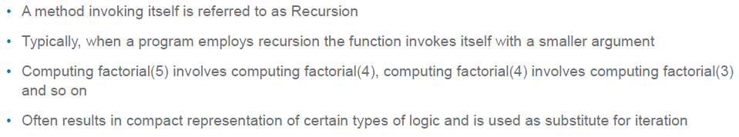
Recursion

Slide 3
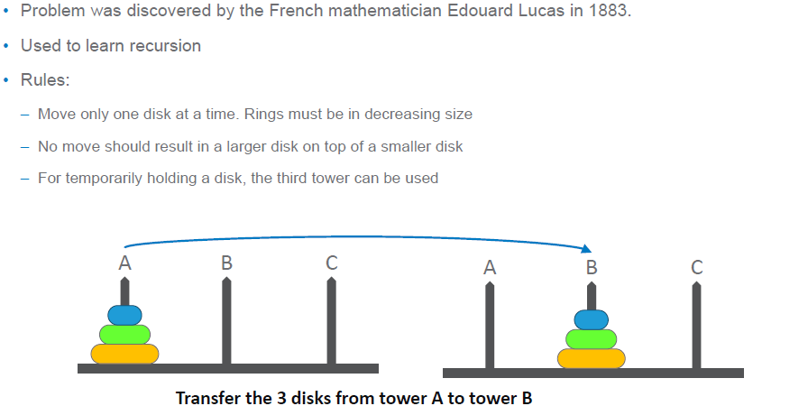
Tower of Hanoi Problem

Slide 4
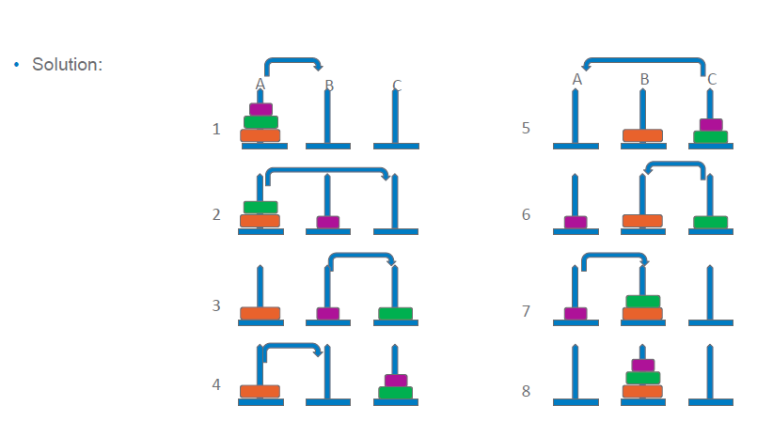

Slide 5
def toh(source,destination,aux,n):
if n>=1:
toh(source,aux,destination,n-1)
print("Move",source,"to",destination)
toh(aux,destination,source,n-1)
toh('A','B','C',3)

Slide 6
Programs
WAP to find the factorial of a number provided by user using Recursion.
WAP to print the fibonacci Series upto n terms, where n is provided by user.
WAP to find the GCD (or HCF) using Recursion.
WAP to input a string from the user and check whether it is palindrome or not.

Slide 7
Lambda Functions or Anonymous Functions
Those Functions which does not have any name is called Anonymous Functions. In Python, this can be achieved by using keyword lambda, that’s why it is also called Lambda Functions.
They are not declared in the standard manner by using the def keyword
Lambda forms can take any number of arguments but return just one value in the form of an expression. They cannot contain commands or multiple expressions.

Slide 8
Syntax
The syntax of lambda functions contains only a single statement, which is as follows:
lambda arg1 ,arg2,.....argn:expression
Example:
add = lambda a, b : a + b
print("Value of total : ", add( 10, 20 ) )

Slide 9
Non-Anonymous Function | Anonymous Function
def square(x): return x*x n=int(input(“Enter the Number”)) print(square(n)) | a=lambda x:x*x n=int(input(“Enter the Number”)) print(a(n))

Slide 10
Lambda Function with map() function
l=list(map(int,input().split()))
Similarly
L1=[1,2,3,4]
L2=list(map(lambda x:x*x,L1))
print(L2)
Output:[1,4,9,16]

Slide 11
Lambda Function with filter() function
L1=[1,2,3,4]
L2=list(filter(lambda x:x%2==0,L1))
print(L2)
Output:[2,4]

Slide 12
Lambda Function with reduce() function
import functools
L1=[1,2,3,4,5,6,7,8,9,10]
L2=functools.reduce((lambda a , b : a+b), L1)
print(L2)
Output:55

